Slide 1
Curriculum Leaders Meeting
November 21, 2025
Fort Hays State University
Hays, KS

Slide 2


Slide 3
Kansas Instructional Leaders Association
Slides

Slide 4
Curriculum Leaders Meeting
November 21, 2025
Fort Hays State University
Hays, KS

Slide 5
Welcome
Dr. Renee Nugent

Slide 6
Expectations for today
Deep Dive in Data
Collaboration
Learning from Colleagues
Training– during afternoon breakout sessions (2)
  Strengthening Standards Alignment
  Deepening Understanding of Implementation Standards
  HQIM Adoption and Support
  Using Kindergarten Readiness Data
  Career and Technical Education

Slide 7
Dr. Watson

Slide 8
Deep Dive into Walkthrough Data
Dr. Nugent

Slide 9
Table Groups
Move tables to sit with at least one other district of a similar size
  1A/2A districts toward the front
  3A/4A districts in the middle
  5A/6A district toward the back
If you brought your walkthrough data, please pull it up now.
If you do not have walkthrough data, join any table.

Slide 10
What Can Walkthrough Data Tell Us?
Patterns in instructional practice
Student engagement
Curriculum implementation
Consistency in learning targets
Use of formative assessment

Slide 11
Individual Reflection
Take a few minutes to look through your data
  Focus on patterns, not individual data points
  Consider the “so what” and “now what”
What trends or patterns do you notice?
What questions or surprises emerged?
Are there differences by grade level, content area, or building?

Slide 12
Table Discussion
Walkthrough Strategies
  What walkthrough strategies are you using that work well in your district?
Instructional Practice
  What strengths are most evident in your walkthrough data?
  Where are practices inconsistent or not yet at scale?
  What might explain those patterns?

Slide 13
Table Discussion
Implementation
  How does this data connect to your KESA action plan priorities?
  What might this data suggest about professional learning needs or curriculum implementation?
  What does the data tell you about the effectiveness of your professional learning?
Barriers and Supports
  What barriers are getting in the way of consistent implementation?
  What data would help you better interpret what you’re seeing?
  What supports (e.g., coaching, planning time, resources) are helping move practice forward?

Slide 14
Table Discussion
Connecting to Action
  What is one insight your district team will take back from this discussion?
  What might be a next step for your local team based on this data?

Slide 15
Linking Data to Outcomes
Dr. Brooke Wells

Slide 16
What is Data?
Data are pieces of information. It can be…
  qualitative and quantitative.
  collected at different levels (district v. building v. grade v. teacher v. student)
  collected at different time points for different purposes

Slide 17
What Does Data Do?
Data, by itself, doesn’t do anything
For data to be more than just a piece of information, you (educators, curriculum leaders, administrators) must:
  Accurately interpret that data,
  Have a clear purpose or use of that information, and
  Act on that information and purpose.
Data is the raw information. Data outcomes are the quantitative or qualitative conclusions drawn from the data points.

Slide 18
Student Driven Data Outcomes
Student driven data outcomes are the measurable result or accumulation of information
Data outcomes are meaningful and measurable
These outcomes answer questions such as:
  What do students know?
  How engaged are students?
  To what extent do students retain and understand information?
  Have students met academic goals?

Slide 19
Student Driven Data Outcomes
What are some student driven data outcomes used in your district?
Examples:
  Academic Performance Data
    Formative data, local and state assessments
  Graduation and Postsecondary
  Attendance and Chronic Absenteeism

Slide 20
Making Sense of Data
To make sense of data outcomes and improve metrics, it is important to understand the context around that data outcome

Slide 21
Think-Pair-Share
What is one data outcome that your district focuses on?
What are the district's recent metric trends? What are your outcome related goals?
What does the data outcome measure? What data informs this outcome?
How often is this data outcome collected and reviewed?
Who uses this data outcome (administrators, building leaders, teachers, etc.)?
Why is this meaningful? In what ways do these people use the data outcome? Be specific about how people in different roles use the data outcome.

Slide 22
Making Sense of Data
We often collect data from different sources—walkthroughs, local assessments, state tests—but how do we see the throughline between them?
Depending on the type of student data outcome, there can be different indicators of improvement.
Early indicators of improvement include formative assessment gains, student engagement metrics, etc.

Slide 23
Think-Pair-Share
Consider the data that influences this outcome. What are early indicators of improvement that do not directly measure the data outcome?
In what ways are teachers and other professionals leveraging these early indicators as a way to impact data outcomes?
Is this working? How do you know? What are ways to better leverage early indicators to meet data outcome goals?

Slide 24
Improving Data Outcomes
Knowing what information impacts or influences the data outcomes help provide clarity and purpose for how to use the data outcome.
Our challenge is to find the signals of progress early, not just after summative results. Leveraging early indicators of improvement is one way to do that.
Teachers are often the ones doing the “work” to help get students to reach data outcome goals but what is the role of leaders and administrators?

Slide 25
Think-Pair-Share
Think about coherence: Are your walkthrough trends and student outcomes telling the same story?
What steps can you take to strengthen the connection between instructional walkthroughs and outcome data?

Slide 26
Sharing Data Stories
Dr. Nugent

Slide 27
Communicating About Data
What makes a “data story” effective?
  Clarity
  Connection to goals
  Actionable takeaways

Slide 28
District Share-Outs
USD 430 South Brown County
USDE 489 Hays

Slide 29
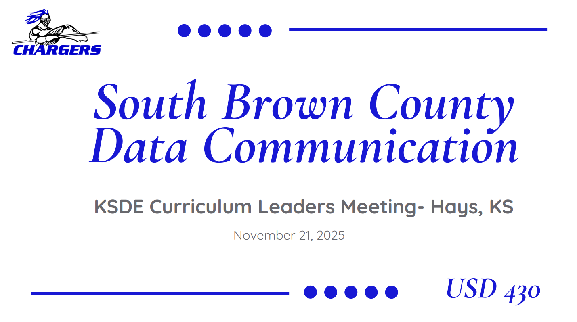

Slide 30
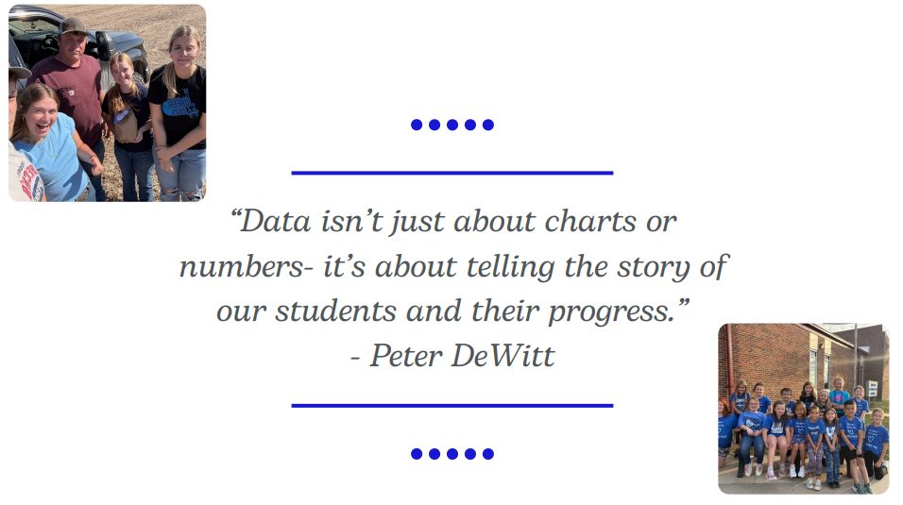

Slide 31
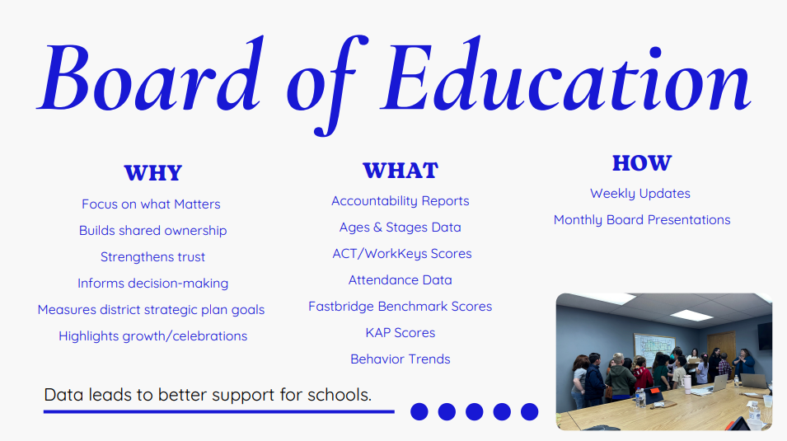

Slide 32
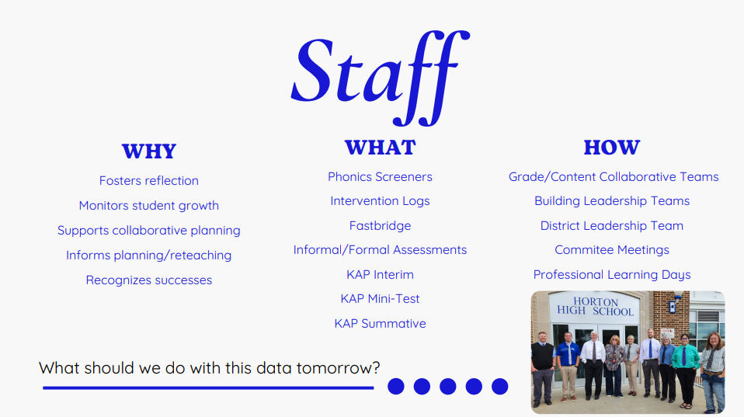

Slide 33
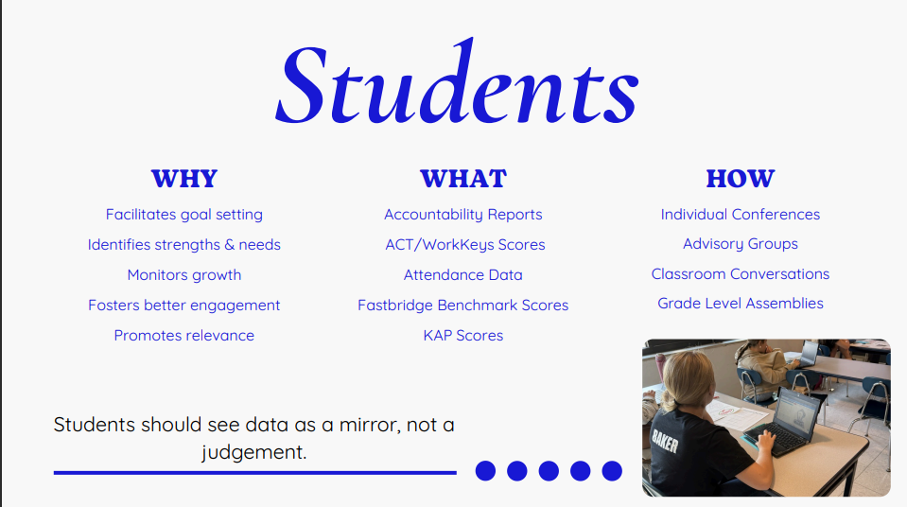

Slide 34
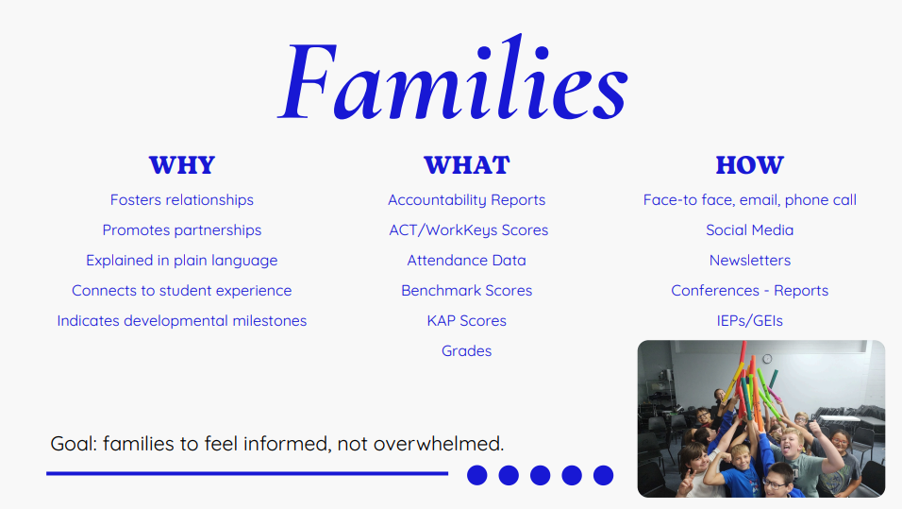

Slide 35
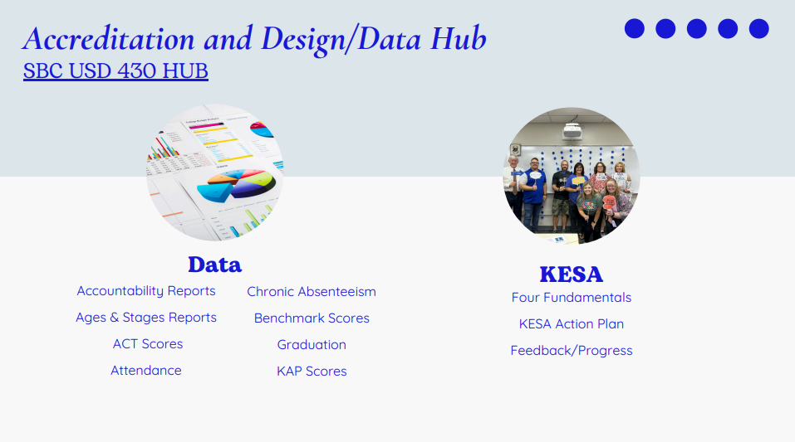

Slide 36
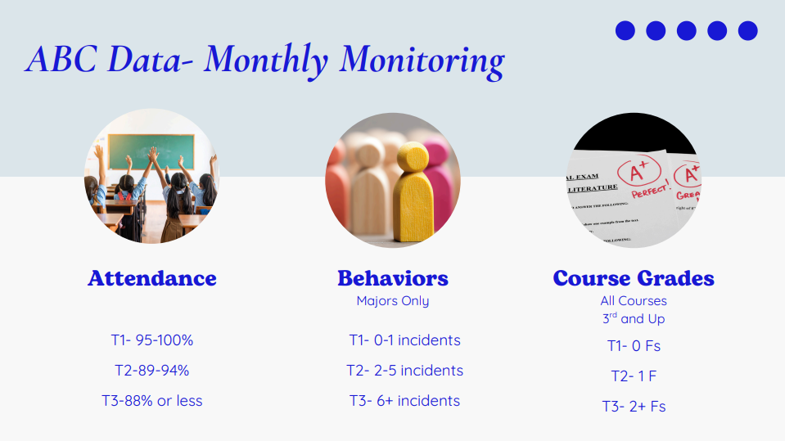

Slide 37
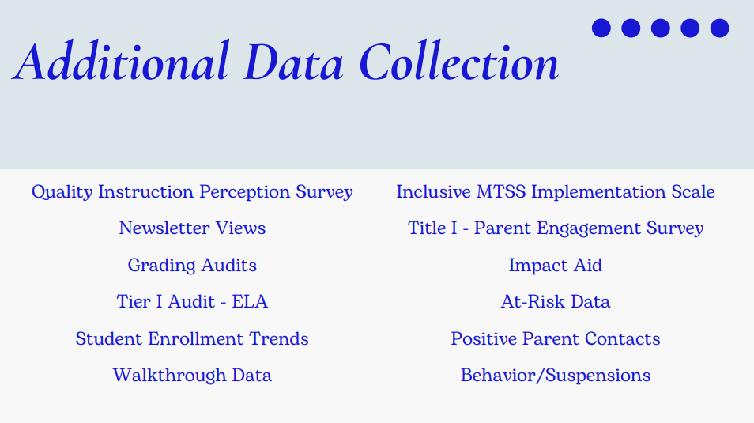

Slide 38


Slide 39
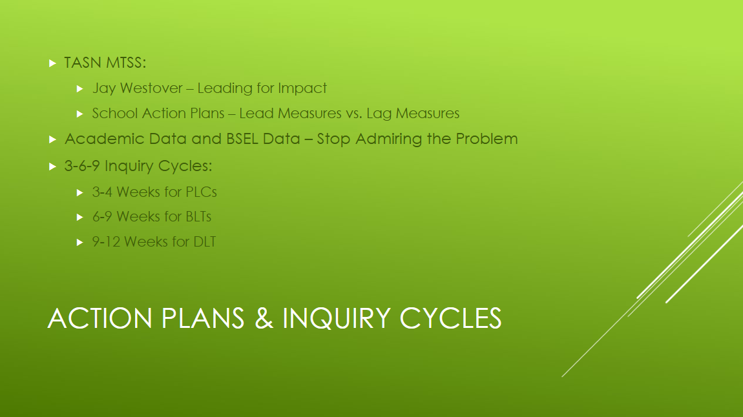

Slide 40
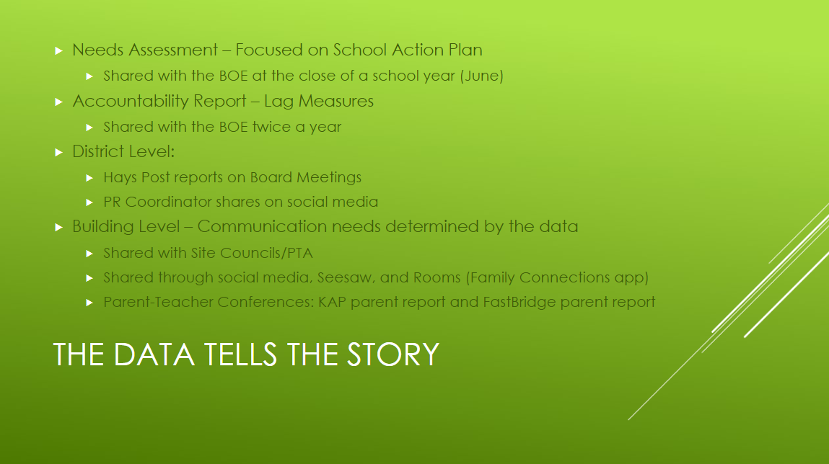

Slide 41
Discussion
If you shared one new data story this semester, what would it be and who needs to hear it?
What’s replicable from what you heard today for your context?
How do you balance transparency (being open with results) with clarity and context (helping others interpret what it means)?
What support would help you share data more effectively in your district?

Slide 42

Lunch

Slide 43
Breakout Sessions 12:30 – 1:15
1:30 – 2:15
Strengthening Standards Alignment ELA/HGSS – Ballroom
Deepening Understanding of Implementation Standards - Ballroom
Strengthening Standards Alignment Math/Science– Trails Room
Using Kindergarten Readiness Data – Smoky Hill Room
Career and Technical Education – Stauffer Room

Slide 44
Reflections and Final Thoughts
Dr. Nugent

Slide 45
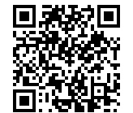
Survey
Please complete this short survey which will guide KSDE as we develop future meeting agendas to meet your needs.
https://www.surveymonkey.com/r/D6JJWRZ

Slide 46
KSDE Great Ideas In Education Conference
July 26-29, 2026
Hyatt Regency and Century II
Wichita, KS

Slide 47
How do I connect
KSDEweekly Newsletter from the department. Email: ksdeweekly@ksde.gov
Curriculum Leaders Listserv (connect with Curriculum Leaders information) Email: pat.bone@ksde.org
Website: https://www.ksde.gov/Agency/Division-of-Learning-Services/Curriculum-Leaders

Slide 48
Next Meeting
January 30 ,2026
Bishop Professional Development Center
Topeka

Slide 49

Renee Nugent
Deputy Commissioner
Division of Learning Services
(785) 296-2303
Renee.nugent@ksde.gov
www.ksde.gov
Pat Bone
Senior Administrative Specialist
Division of Learning Services
785-296-2303
Pat.bone@ksde.gov
www.ksde.gov

